Slide 1
Bridging the Digital Divide: Challenges and Opportunities in Rural Broadband Access and Adoption in Tennessee
Sreedhar Upendram, Ph.D.
Assistant Professor and Community Economic Development Specialist
Department of Agricultural Economics
University of Tennessee
Cloud and Edge Computing
November 5, 2021

Slide 2
Research/Extension
Research – 75% and Extension – 25%
Program Areas:
  Community economics and business development
  Economic and fiscal impact analysis
  Natural resource economics
Research and Extension Themes:
  Affordability and Community Sustainability
  Enhance rural-urban linkages to drive social, economic transformation
  Protect natural resources and environment through planning, management and conservation

Slide 3
Outline
Motivation
Challenges and Opportunities
Programs in Tennessee
Market Power
Broadband as public good
Summary and Conclusions

Slide 4
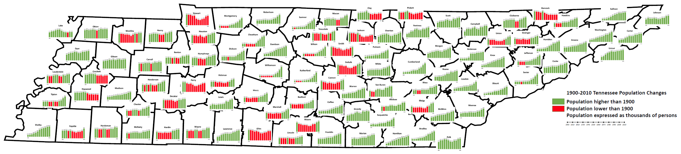
1900-2010 Population changes
Notes:
TN population tripled in the past century
Rural areas shrank while urban areas grew at a faster pace
Presence of interstate highways (I-40, I-24, I-81 and I-75), natural amenities have an increased propensity to attract population and workforce
Highland rim area displayed a steady decline in population over the years
Counties with high growth – Rutherford, Williamson, Cumberland, Blount and Bradley
Counties with greatest population declines – Hancock, Haywood, Jackson, Stewart and Giles
Women outnumber men by 159,097

Slide 5
Motivation
Anecdotal evidence of families spending time in McDonald’s parking lots to access internet, so that children can complete homework
August 2017 Rural Task Force Town Hall Meeting in Maynardville, TN – opinion poll:
  Broadband access
  Opioid issues
Data on broadband access and inputs from Extension agents across Tennessee

Slide 6
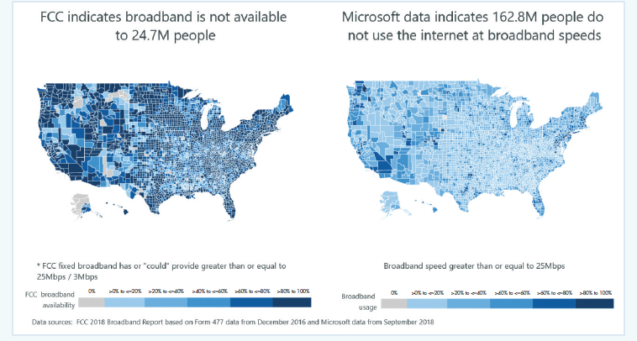
FCC vs Microsoft data
Source: Disconnected, The Federal Reserve Bank of Kansas City
Notes:
FCC data was at the block level
Microsoft data was more granular – pinging computers using Microsoft operating system, Xbox, etc.

Slide 7
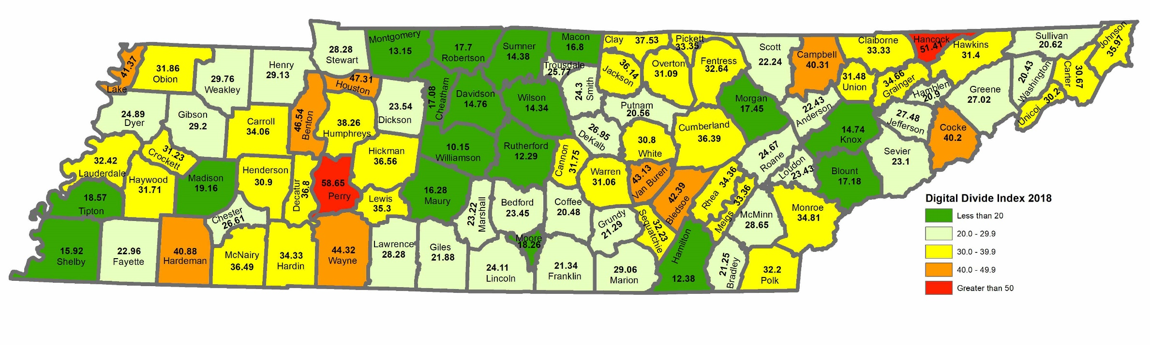
Digital Divide in Tennessee
Source: Purdue 2018 Digital Divide Index
Digital divide is defined as the gap between underserved communities that have poor or limited internet access and the communities that have relatively better access to broadband internet (25 download/3 upload megabits per second)
Digital Divide index:
  An index of 100 indicates highest digital divide and that of 0 indicates no digital divide
  Tennessee digital divide index ranges from 10.15 to 58.65.
  Only 53.4% of Tennessee residents in 2019 have adopted broadband

Slide 8
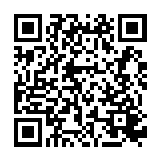

TN Digital Divide Webpage
Tennessee Digital Divide webpage:
https://tiny.utk.edu/tnddi or use QR code

Slide 9
Digital Divide Index Data and Methods
Variable Name | Description | Weight
Infrastructure |  | 1.0
NBBND | Percent population with no access to fixed broadband | 0.3
NIA | Percent households with no internet access | 0.3
NCD | Percent households with no computing device | 0.3
DNS | Median advertised fixed download speed | 0.05
UPS | Median advertised fixed upload speed | 0.05
The infrastructure score/adoption score is calculated based on the following equation:
INFA = NBBND*0.3 + NIA*0.3 + NCD*0.3 – DNS*0.05 – UPS*0.05
Variable Name | Description | Weight
Socio-economic |  | 1.0
AGE65 | Percent of population aged 65 and older | 0.25
POV | Percent of population aged 25 and older with less than high school | 0.25
LTHS | Individuals in poverty | 0.25
DIS | Percent of population with a disability | 0.25
The socio-economic score (SE) is calculated based on the following equation:
SE = AGE65*0.25 + POV*0.25 + LTHS*0.25 + DIS*0.25

Slide 10
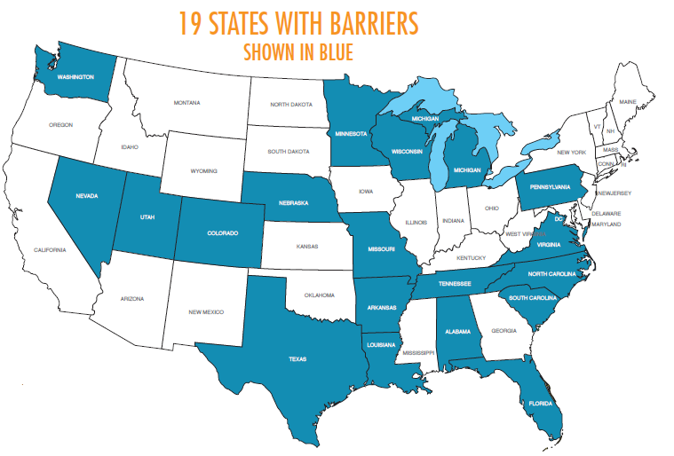
Broadband Challenges in Tennessee
Barriers to broadband expansion: Tennessee is among 19 states in the U.S. that have barriers in developing municipally owned broadband networks
Population density:
  Tennessee: 161.3 people per square mile.
  Metropolitan counties: 252.3 people per square mile
  Micropolitan counties: 89.5 people per square mile
  Non-core counties:44.9 people per square mile.
Right-of-way or easements: Slow and laborious
Topography: Presence of hills, valleys and tree coverage
Low Adoption and use in rural Tennessee: reliable signal and affordability
COVID-19 pandemic: broadband access was a huge challenge for many rural students and remote workers
Source: Disconnected,
The Federal Reserve Bank of Kansas City

Slide 11
Library mobile internet hotspot program
Patrons can check out internet hotspots for 2-3 days free-of-charge
Compliance with library policy and University of Tennessee Information Technology policy.
Fill out a short survey on usage, experience and willingness to pay for internet
Local public libraries administer the program in collaboration with University of Tennessee Extension
Internet speed tests – University of Tennessee Extension and librarians

Slide 12
Results

Slide 13
Educational attainment and Income

Slide 14
Limitations
One of the biggest challenge – internet signal strength – terrain, hills, valleys.
Sustainability with Federal E-rate program – librarians reluctant due to paperwork
Buy-in from County Commission and local Government
Entertainment and social media use – incentivize educational program and training workforce development

Slide 15
Summary of Mobile Library Hotspot Lending Program
Helped 109 families with children to access internet for school work
Helped 395 adults in rural communities to access internet
High interest and demand for internet in rural communities in TN – waitlist of 30+
Over 90% of users highly satisfied and 84% likely to recommend to family/friends
Findings from this study - leverage funding with State and Federal agencies
Opportunities to partner with other libraries, school districts, state parks and healthcare providers

Slide 16
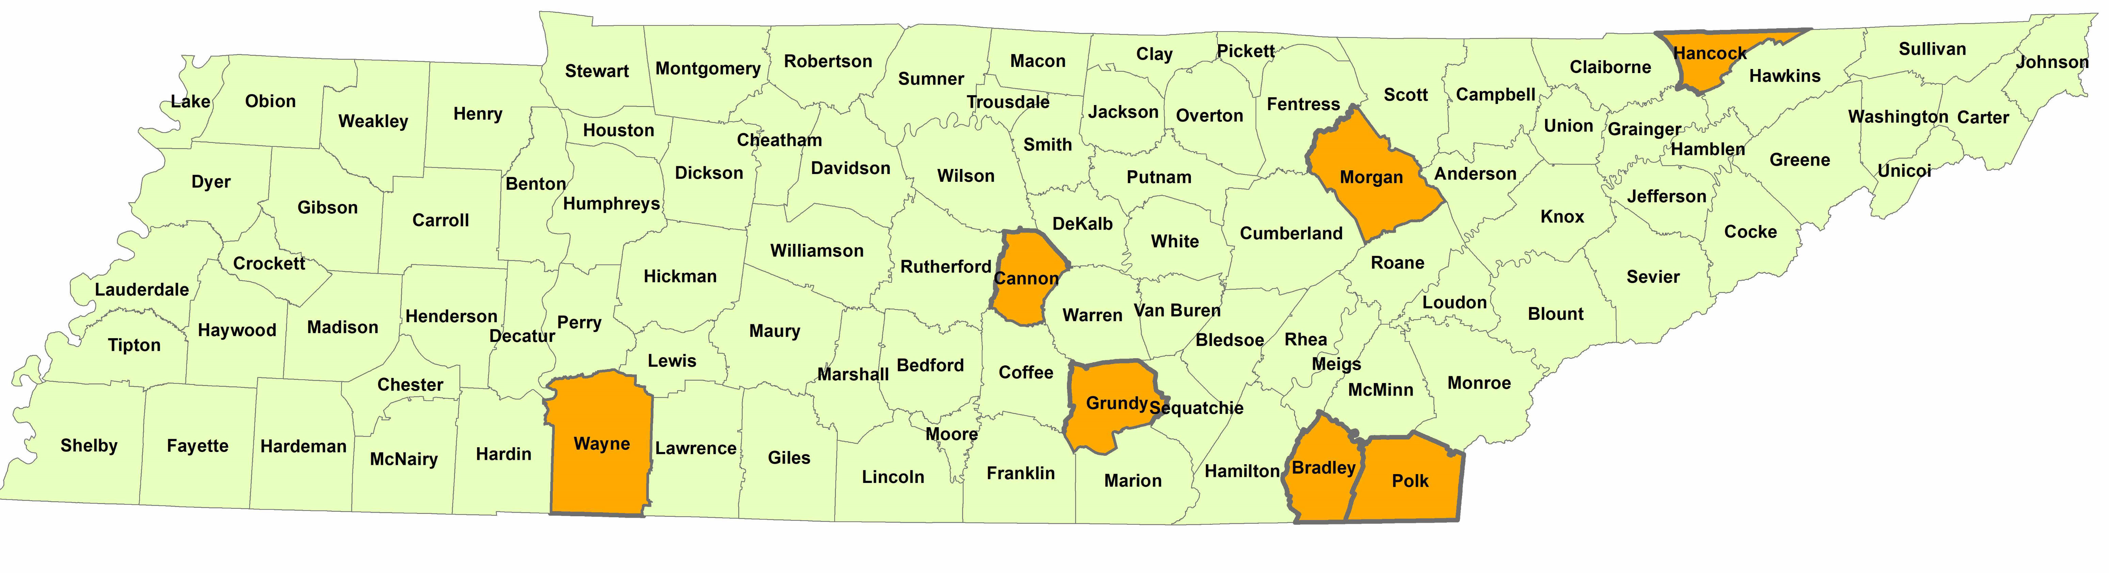
Community Engaged Seed Grant: Access
Phase II Program:
Hancock – 2 hotspots
Morgan – 2 hotspots
Cannon – 2 hotspots
Grundy – 2 hotspots
Bradley – 11 hotspots
Polk – 2 hotspots
Wayne – 2 hotspots
Pilot program had 162 rural households provided with internet access in Hancock, Bledsoe and Wayne counties, by partnering with public libraries. Mobile hotspots were checked out more than 13 times per month, on average.

Slide 17
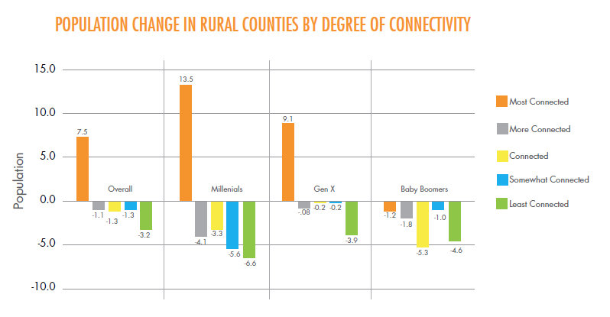
Source: Disconnected, The Federal Reserve Bank of Kansas City

Slide 18
Broadband and wages

Slide 19
Broadband
Community Economic Development
Access & Affordability
Adoption
& Use
Digital Inclusion
Notes:
- The objective of this slide is to really emphasize that for community economic development to take place broadband infrastructure is but one component; adoption & use and all that it implies is also needed if any community wants to design and deploy an effective and robust digital inclusion strategy.

Slide 20
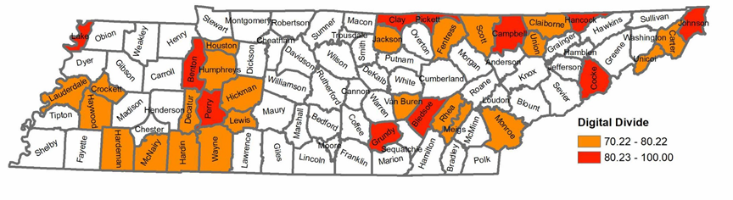
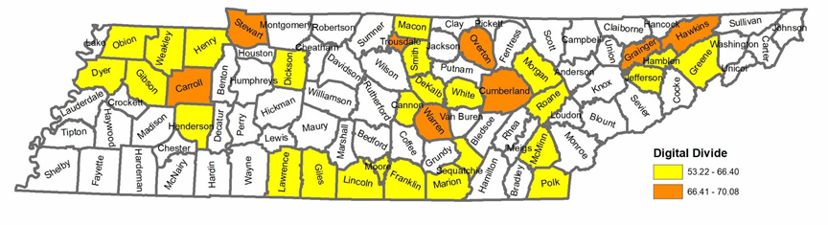
One UT Grant: Digital Literacy - Adoption
Year 1: 34 Counties
Eastern Region: 14
Central Region: 5
Western Region: 15
Year 2: 34 Counties
Eastern Region: 10
Central Region: 14
Western Region: 10
*Counties and years are subject to change

Slide 21
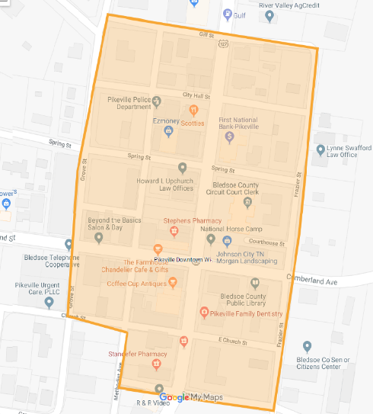
ARC Grant: Pikeville Downtown Wifi Program
Appalachian Regional Commission’s Grant - Downtown Wi-Fi Grant - $75,000:
  Offers free internet to residents and visitors for 1 year
  Surveys – business owners, Farmers’ market vendors, local government offices and visitors

Slide 22
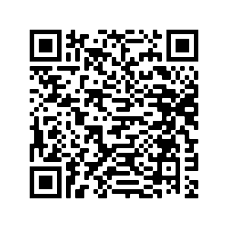
Mentimeter Poll
Go to www.menti.com and use the code
9316 2774
https://www.menti.com/1pcofn5z8g
Answer 2 questions:
  What is the download speed of your broadband
  How much do you pay for broadband?

Slide 23
Market Power
One ISP provider in many counties
High broadband prices –$70+/month
Prices out most rural and economically distressed households

Slide 24
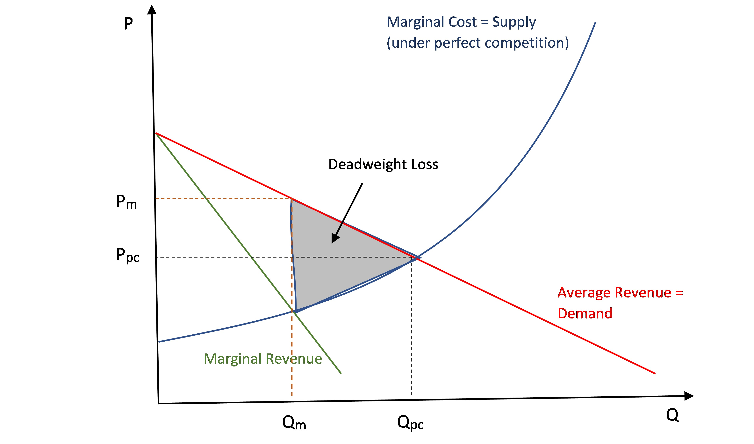
Perfect Competition vs Monopoly Power
Market under perfect competition vs monopoly
Deadweight loss – societal cost due to market inefficiency
High Price leads to fewer subscriptions, less access and welfare loss
Pareto optimal solution:
  if no alternative can make someone better off without making someone else worse off
  cheaper, more efficient and more reliable

Slide 25
Market Failure
Market failure is an economic situation when goods and services are not distributed efficiently in a free market
Individual incentives for rational behavior does not lead to rational outcomes
Individuals make decisions that are self-fulfilling but wrong decisions for the group/market
It ends up in a steady state disequilibrium i.e. supply does not equal quantity demanded.

Slide 26
Game Theory
The Players
  Who is involved?
The rules:
  Who moves when?
  What do they know when they move?
  What can they do?
The outcomes:
  For each possible set of actions by the players, what is the outcome of the game?
The payoffs:
  What are the players’ preferences over the possible outcomes?

Slide 27
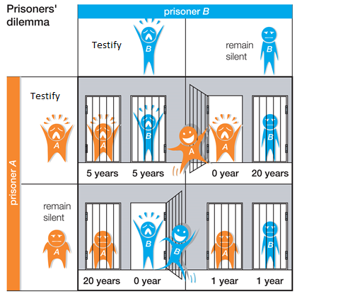
Game Theory – Prisoner’s Dilemma
Classic game theory example:
  3 possible outcomes: both confess, 1 confesses, neither confesses
  From individual perspective, most rational choice is to act selfishly and not cooperate
  Best outcome overall is to act unselfishly and cooperate

Slide 28
Outcomes and Impacts
Perfect information – where both parties have complete information and risk and rewards
Equilibrium – would it lead to a stable or an unstable equilibrium?
Nash equilibrium - Each individual’s strategy is a best response to the strategy actually played by his rival and rationalizable

Slide 29
Broadband Access
 |  | Consumers
 |  | Cooperate |  | Don’t Cooperate
Internet Provider | Cooperate | 10 | 10 | 0 | 5
 | Don’t Cooperate | 5 | 0 | 1 | 1
Internet provider:
Cooperates: Invest in technology, provide more affordable internet
Reward: Higher market share, Profits in the long-term
Risk: Return on investment
Consumers:
Cooperates: Adoption of broadband, Faster internet
Reward: Reliable and affordable internet; Equity in access
Risk: Access to broadband

Slide 30
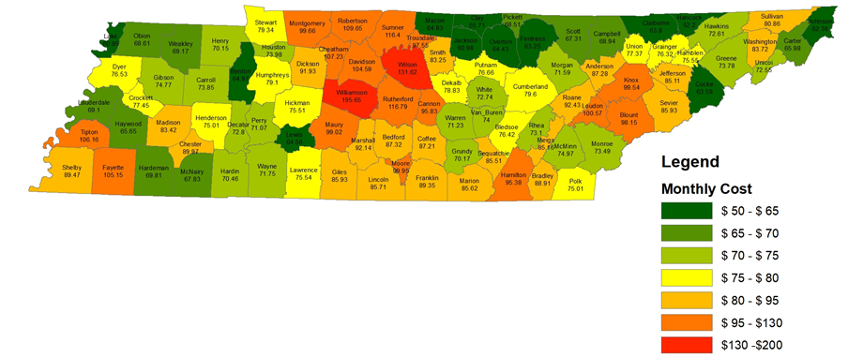
Tennessee Broadband Affordability
2% of Median Household Income
High economic burden for underserved populations
Decreases broadband access and equity
Provide limited broadband at an affordable rate
Ex: 10GB data limit on broadband for $10/month?

Slide 31
Broadband – Exclusive and Rival
 | Exclusive | Non-exclusive
Rival | Private goods Ex: food, clothing, car, house | Common goods Ex: fish in open sea, atmosphere, public waterways, Parks
Non-rival | Club/Membership, Ex: Cable television, gym/clubs | Public goods Ex: Law enforcement, Street lighting, Emergency services
Non-exclusive: Not exclude individuals from access
Non-rival: Access of good by one individual does not reduce availability to others
Internet as a public good

Slide 32
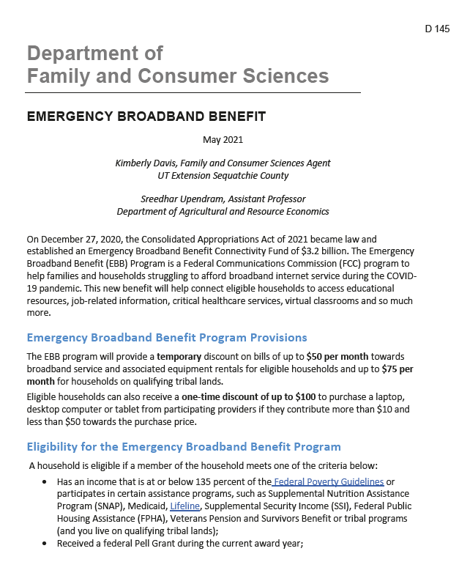
Emergency Broadband Benefit
Temporary benefit of $50 - $75 per month
One-time discount of up to $100 for device
Eligibility:
  135% of Federal poverty
  SNAP
  Medicaid
  Lifeline
  Supplemental Security Income
  Federal Public Housing Assistance
  Veterans Pension
  Survival Benefit or tribal program
  Reduced lunch or free lunch at school

Slide 33
Summary and Conclusions
COVID-19 pandemic highlighted consequences of digital divide
Demand-side management – incentives, subsidies and vouchers for consumers
More than one ISP in each community may improve access and lower pricing that is affordable
Treat internet as a public good to improve access and adoption
Trade improves welfare for all parties!

Slide 34
References
Digital Divide Index – Purdue University
Broadband Now – Internet access in Tennessee
Community Networks
Disconnected – The Federal Reserve Bank of Kansas City
https://georgia4h.org/programs/focus-areas/agriculture-stem/science-technology-engineering-math/digital-ambassadors/

Slide 35
Questions?
Sreedhar Upendram, Ph.D.
Assistant Professor
Department of Agricultural and Resource Economics
227C Morgan Hall, 2621 Morgan Circle
Knoxville, TN 37996-4518
865-974-7410 Office
supendra@utk.edu

Slide 37
Socio-economic data
Site | 2017 Population | 2017 Poverty rate | 2017 Median Household income
Hancock County | 6,605 | 20.8% | $31,046
Bledsoe County | 14,413 | 14.3% | $42,398
Wayne County | 16,713 | 16.8% | $35,951
Tennessee | 6,597,381 | 15.0% | $53,813
Source: 2013-2017 American Community Survey, U.S. Census Bureau

